Slide 1

2023 Insurance Plan Design
Deductibles / Coinsurance / Max out of Pocket
$$$$ how to balance premiums with great benefits
Presenter:
Kent Friend
National Strategic Benefits Consultant
Commercial Property & Casualty

Slide 2

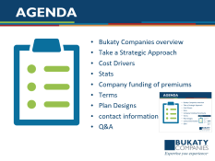

Agenda
Bukaty Companies overview
Take a Strategic Approach
Cost Drivers
Stats
Company funding of premiums
Terms
Plan Designs
contact information
Q&A

Slide 3


Bukaty Companies
30 Years in Business
Locally owned & operated
Financially strong
275+ Employees – 6 Divisions
Licensed in all 50 states
  Employee Benefits
  HR Consulting
  Benefit Administration
  Property & Casualty
  Payroll & Accounting Services
  401(k) & Wealth Management
Top producer designations
  BCBS of KC – Blue Chip Cigna – Platinum Producer
  Aetna – Super Elite
  Humana – Leaders Club
  United Healthcare – Platinum
5

Slide 4
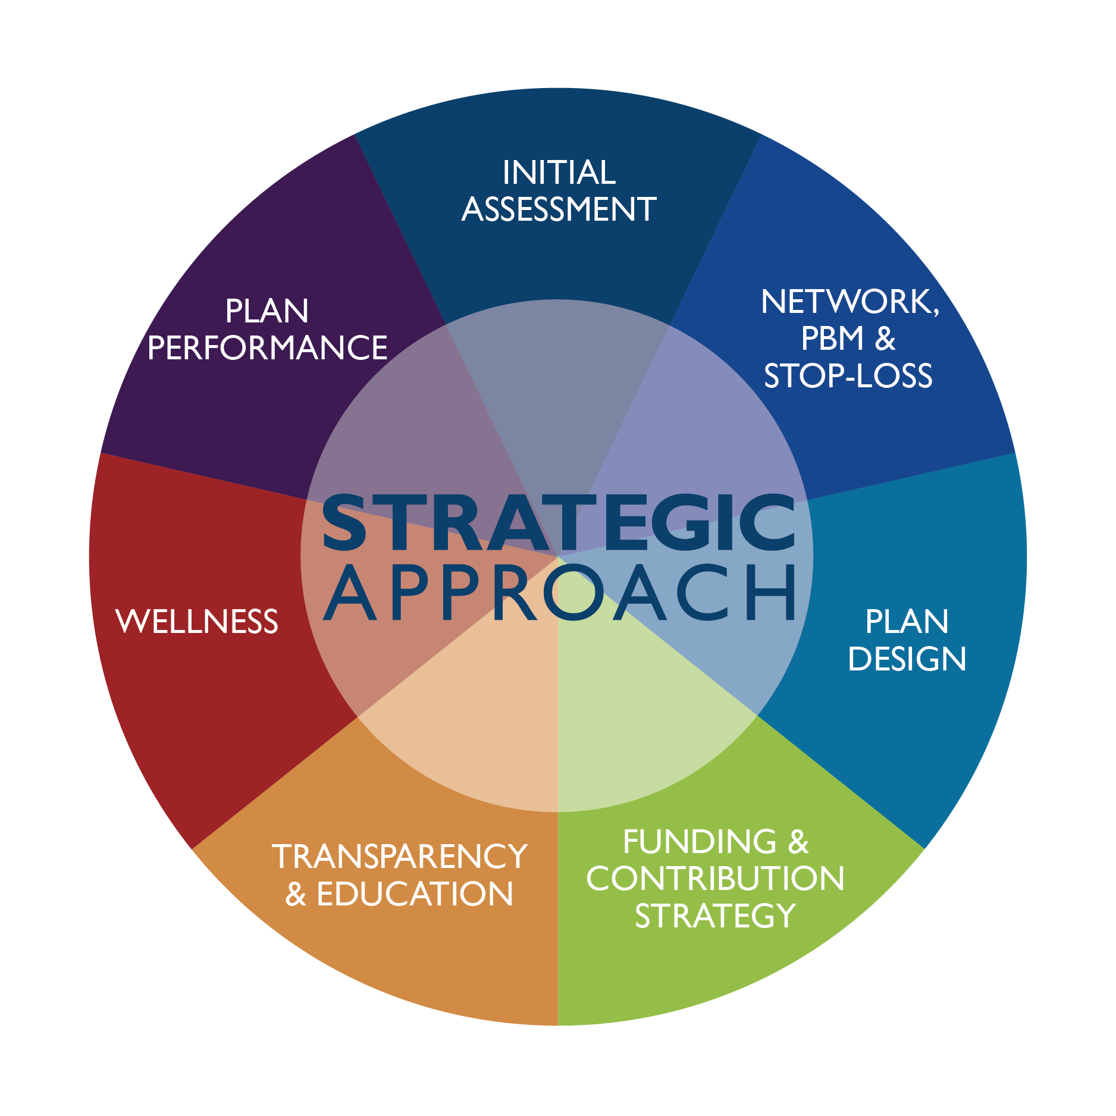
A Strategic Approach

Slide 5
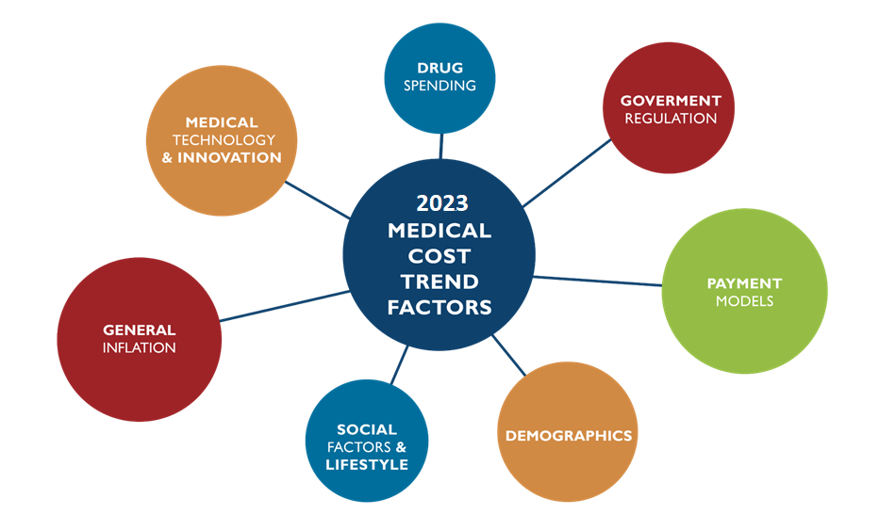
medical cost spend factors

Slide 6
Reporting
Industry Statistics
98% of employers offer health care coverage for their employees¹,
of those
  24% offer an HDHP/HRA or an HSA qualified HDHP, or both²
  75% of employers offer wellness resources and/or a general
  wellness program³
The average total employee health care premium per employee in
2022 was $574 per month/ family $1,634
Medical cost trend is predicted to be 6% in 2021(some say 10-12%)
Employee benefits make up approximately one-third of total
compensation costs³
More than two-thirds of employers increased their benefit offerings
to retain employees in the last 12 months³
¹SHRM 2017-20 Health Care Benchmarking Report
²Kaiser/HRET Survey of Employer-Sponsored Health Benefits, 2017-20
³SHRM 2018-20 Employee Benefits Report
⁴PWC Medical Cost Trend: Behind the numbers 2019-20

Slide 7
HEALTH INSURANCE PREMIUMS AND WORKER CONTRIBUTIONS
In 2021, the average annual premiums for employer-sponsored health insurance are $7,739 for single coverage and $22,221 for family coverage [Figure A]. The average single and family premiums increased 4% over the past year. During this period, workers’ wages increased 5% and inflation increased 1.9%.²
The average premium for family coverage has increased 22% over the last five years and 47% over the last ten years [Figure A].
Covered workers in small and large firms have similar premiums for single coverage ($7,813 vs. $7,709) and family coverage ($21,804 vs. $22,389). The average premiums for covered workers in firms with a relatively large share of lower-wage workers (where at least 35% of the workers earn $28,000 annually or less) are lower than the average premiums for covered workers in firms with a smaller share of lower-wage workers for single coverage ($7,156 vs. $7,796) and family coverage ($20,315 vs. $22,407)³. The average premiums for covered workers in high-deductible health plans with a savings option (HDHP/SO) are lower that the overall average premiums for single coverage ($7,016) and family coverage ($20,802) [Figure B]. In contrast, the average premiums for covered workers enrolled in PPOs are higher that the overall average premiums for single ($8,092) and family coverage ($23,312).

Slide 8
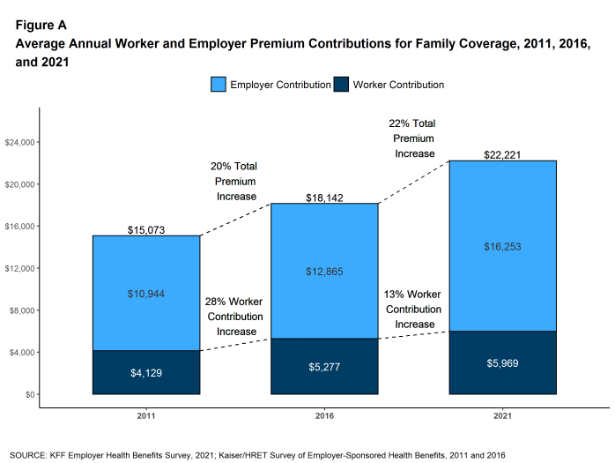
Employer Premium Contributions

Slide 9
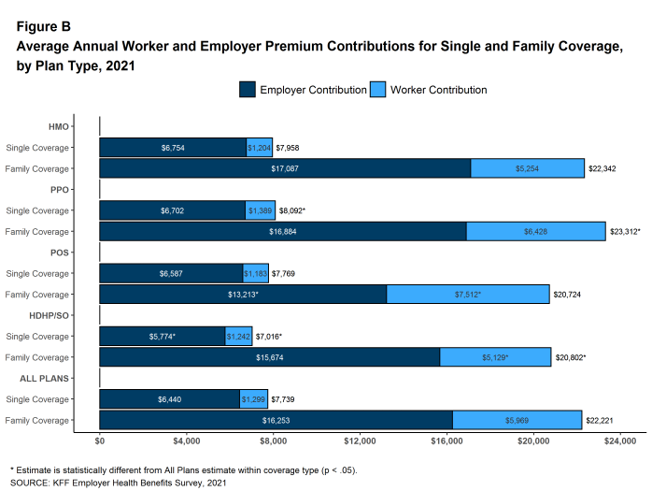
Employer Premium Contribution

Slide 10
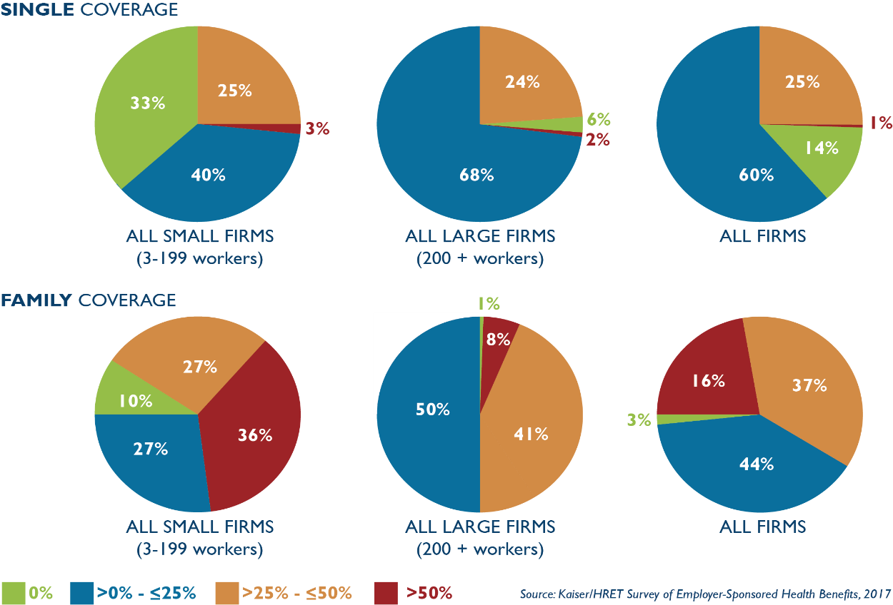
Reporting
Funding & Contribution
Average premium for single coverage in 2022 is $6,900 per year
Average premium for family coverage in 2022 is $20,100 per year
Distribution of percentage of premium paid by covered workers for single and family coverage, by firm size, 2022

Slide 11
Terms
Deductible-
The amount a person has to pay towards medical procedures before the Insurance carrier starts to pay.
Coinsurance-
  That is the percentage you pay and the percentage the Carrier pays of each medical bill. 100% 80/20 70/30 50/50
Max Out of Pocket-
The total amount of money one would spend for all medical costs for the year though insurance.
Inpatient
Medical expenses incurred while getting treatment in a hospital –overnight stay usually
Out-Patient
Medical expenses incurred while getting treatment in a surgical center – no overnight

Slide 12
Terms
Pharmacy –
The cost the employee pays for prescription drugs
Tier 1 – Generic
Tier 2 – Brand Name
Tier 3 – Specialty drugs
Tier 4 – Infusion Drugs
Retail Pharmacy –
You pick up your medications monthly at the local pharmacy.
Mail order Pharmacy-
Usually, a 15% to 30% savings by signing up for mail order, auto refills for maintenance drugs.

Slide 13
Terms
Age Rated
Premiums based on the employee’ age
Composite Rated
Premiums based on underwriting
In Network Benefits
Providers / Facilities that agrees to work with your insurance carrier and gives a bigger discount than network providers
Out of Network Benefits
Providers / Facilities that do not accept your insurance
Warning – do not go to Out of Network providers or facilities

Slide 14
Terms
Tiers
EE – Employee
ES - Employee & Spouse
EC - Employee & Child (ren)
FAM – Employee & Spouse + Child (ren)

Slide 15
Ways to Cut Costs
1) Align with Broker who has access to special products
2) Shop all Carriers
3) Change plan style / design
a. level funded
b. self insured
c. direct contracting
d. referenced based pricing
4) Raise Deductibles / lower coinsurance percentage
5) Steer usage to lower cost / better outcome providers
6) Use a GAP strategy
7) Use an HRA = Health Reimbursement arrangement
8) Reward Good Behavior – put in wellness program = yearly physicals, non- smoking incentives

Slide 16
Selecting the Right Providers
The old way of using a large network is soon to be obsolete. Narrow Networks & selected specialty providers are gaining in popularity. This is being driven by the sheer economics of the old system ….is becoming non affordable!
The good news is hospital systems are starting to allow alternate funding arrangements for Self-insured plans and in some cases are offering their own very limited medical plan programs.
If you still use the major carrier programs, make sure to evaluate their narrow network options.
Make sure to consider plans with no out of network benefits.

Slide 17
Plan Types
Fully-Insured
Level-Funded
Self-Insured
Reference-Based Pricing
Direct Contracting
Captive

Slide 18
Level-Funded Plan Design
A plan design that allows you to have composite rates for groups with less than 50 people on the Medical Insurance.
A portion of the premium goes to Insurance overhead and the rest goes towards paying claims.
No extra risk to the Company or Employee
Locked in premiums for the plan year
If there is money left in the “claims bucket” then the group gets all or a portion of that back - (depending on each carrier)

Slide 19
Direct Contract Plan Design
A plan design that allows you to Bypass the insurance carriers.
Only works for Partially Self-Insured groups.
A fee agreement /schedule is negotiated directly with the Hospital(s) and the TPA (Third Party Administrator) pays the claims.
The fee agreement is typically 1.5 to 1.75 X the Medicare reimbursement rate.
The BUCA rate reimbursement to the Providers is Around 3 X Medicare
Providers accept this form of payment because they get more volume and get paid quicker= less hassle / less man hours.

Slide 20
Reference-Base Pricing Design
A plan design that allows you to Bypass the insurance carriers.
Only works for Partially Self-Insured groups.
A fee agreement /schedule is determined by CMS data (what hospitals are accepting overall / and what the TPA thinks that they will accept.
The fee agreement is typically 1.75 X the Medicare reimbursement rate.
No real network
Providers may not accept this and can possibly balance bill the employee.
Providers accept this form of payment because they get more volume and get paid quicker= less hassle / less man hours.
Growing in popularity

Slide 21
Gap Insurance Plan Design
A plan design that allows you to Raise your medical plan’s deductible and Max out of Pocket up, then fill in that “Gap” with GAP insurance.
Its like an HRA = Health Reimbursement arrangement
Works great with fully insured & level funded groups & age rated plan designs.
Need to have at least 5 people sign up for this.
Not all Brokers can offer this.
When used it typically saves the company / employee $50 to $100 of premium per person per month.

Slide 22
HRA Plan Design
A plan design that allows you to Raise your medical plan’s deductible and Max out of Pocket up, then fill in that with the Employer paying a set amount of money
It can be Company Administered or a TPA can administer this
A person either gets a debit card to use for the amount of medical claims the company is willing to pay or the employee submits receipts to get reimbursed.
Works great with fully insured & level funded groups & age rated plan designs.
Can be a great benefit for the employee.

Slide 23


Slide 24

Contact
Kent Friend
National Strategic Benefits Consultant
Property & Casualty Consultant
kfriend@bukaty.com
P: 913.777.7535
C: 816.803.7406
F: 913.345.2608
To receive more information, please call or email me:

