Slide 1

HR EMPLOYEE RELATIONS
2020 and Beyond
Dori Woodruff, MA, s-HRBP, SHRM-CP, PHR
Notes:
I am going to speak about Employee Relations today.

Slide 2

Agreements
* Participate, participate, participate
* Have fun
* Ask questions before during and after
* There are no right or wrong responses, just honest experiences

Slide 3

It is hard to be a leader!
* Requires high ethical and moral standards.
* You will not make everyone happy… sometimes those people are your managers.
* You are usually alone. The higher you go, the lonelier it gets.
* You have to make the tough decisions and deliver the news people don’t want to hear.
* You have to balance what is best for employees and the organization.
* You are always giving. Sometimes people don’t appreciate you.
* You are under scrutiny. The naysayers always feel they can do your job better.
* People expect perfection. There is little grace given when you hold a high-level position.
* Sometimes, you are worn out! You just need someone to hold your ladder up.

Slide 4

Team Building
WHO’S HOLDING YOUR LADDER?
Reference: Samuel Chand, 2016. Who’s Holding Your Ladder

Slide 5
Think of your current team (direct reports, peers, or both)
Those who you depend on to get your work done. How many do you have?
1. Remove those who need constant reminding. Chasing after people is too much work. They are not dependable.
2. Remove those who behave casually. Leadership is intentional… It does not just happen.
3. Remove the resume builders. Looking at other ladders while holding yours up is not a confidence builder.
4. Remove unhappy people. Anyone can have a bad day, but not an unhappy life.
5. Remove those who are just riding it out to retirement. This person will drop you ladder when the time is right for them.

Slide 6
6. Remove those who criticize your leadership. They cannot hold you up if they don’t believe you should be up there.
7. Remove those with absentee problems. They won’t be available when you need them to hold you up.
8. Remove the blame-shifters. Accountability is a must!
9. Remove your gossipers and troublemakers. They can’t cooperate w/others; will fail at teamwork.
10. Remove those that are not self-aware. They will not be able to provide you an accurate description of their ability.
How many are left holding your ladder?
Can you reach your destined vision with those left holding your ladder?

Slide 7
ENSURE THAT THOSE LEFT HOLDING YOUR LADDER HAVE THE FOLLOWING:
1) They are the foundation of your organization.
2)They are the ones who allow you to reach your highest potential.
3) They have the ladder held so securely that you don’t have to fret or worry about falling.
4) They understand their purpose and why their role is important.
5) They cope with disappointment as well as success?
Did you have to remove any additional people?
If you do not have at least 2 people holding you ladder, you are in trouble.
This is an exercise to emphasize the need to hire and retain the right people.

Slide 8
PROBLEMS HR LEADERS ARE FACING!
Attracting Candidates. COVID made it worse.
Retaining the workforce.
Expectations of current multi-generational workforce.
Government restrictions. (Antiquated titles, low salaries, difficulty reorganizing).
Expectations of Business Partners.
Keeping up with technology that makes HR’s job easier.
Supporting employee wellbeing.

Slide 9
Attracting Candidates
What makes people want to work for your agency?
How do you stand out with all the openings out there?
Are you moving quickly with responses, interviews, and respecting their time?

Slide 10
Retaining Quality Workers
Your employees are your greatest asset.
You have to support them and ensure they have the things that speak to their joy.
You have to communicate honestly about changes and other items of concern.

Slide 11
Expectations of Multi-Generational Workforce
You have to be able to provide situational leadership.
You must understand that different generations have different expectations.
You have to think outside of the 8-5, M-F, come to the office way of work.

Slide 12
Government Restrictions
Policy or precedent provide guidance but can prevent growth.
You must stop thinking about what you cannot do and ask what can you do to attract, retain and manage.
You have to know when things are out of your hands and may need to go higher or outside of your organization.

Slide 13
Expectations of Business Partners
Your business partners are your customers. You have to know if the services you are providing are satisfactory.
You have to look at trends and be strategic. HR is a service center, but should also be a strategic partner.
Do your policies need to be updated or changed? How often are you reviewing them?

Slide 14
Keeping up with technology
Do you have adequate HR systems? Integration with payroll and timekeeping?
How are your employee complaints, grievances, and outside charges tracked?
How do you manage analytics: tracking exit trends, turnover statistics, time to hire, time to fill, etc.?

Slide 15
Supporting Employee Wellbeing
Your employees are going through things outside of work. You have to know them individually.
You have to CARE (Compassion, Authentic, Respect, Encourage). Your door has to remain open.
You have to care about them, their well-being, safety, and matters that concern them.

Slide 16
Why do you have to deal with this?
Your actions and inactions matter!
Your BEHAVIOR is the greatest impact on the culture in your department.
You make the difference in someone having a good or a bad experience.
You are mitigating risks
Notes:
An open door policy can stop the problems and financial risks to the company.

Slide 17
What happens if you don’t deal with it?
Your organization will suffer!
Symptoms of a dysfunctional company will surface
Stagnation and lack of evolution will be the order of business.
Ensuring employees are heard and supported will not happen.
You will be handling more legal matters (i.e. EEOC and Civil suits)

Slide 18


Symptoms of a Dysfunctional Workforce
- Complaints
- Absenteeism
- Turnover
- Discord on the team
- Low productivity (laziness or doing the bare necessity)
- Lack of engagement (withdrawal or complete disengagement)
- Resistance
- Performance problems (messy or careless work)
- Focus on negativity
- Lawsuits
- Customer Complaints
Notes:
.

Slide 19
Are you convinced that being proactive in dealing with the workplace problems is a must?
Let me show you more…

Slide 20
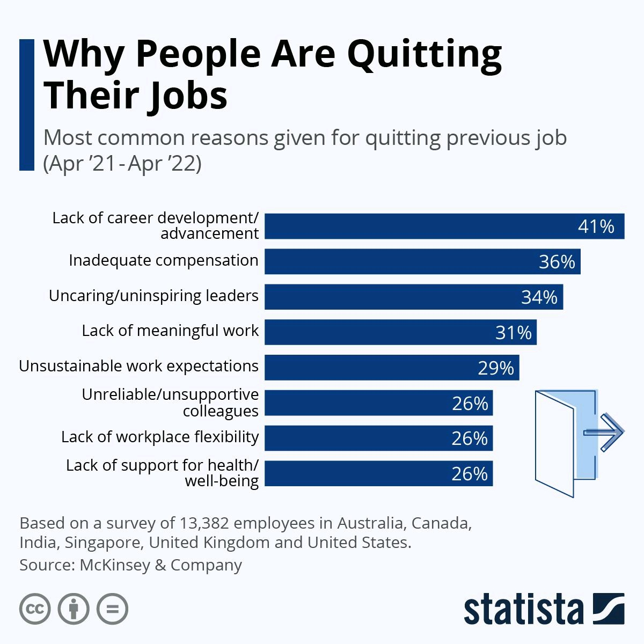
After the “Great Resignation” will things ever go back to our previous “normal”?
Has the change forced us to change our HR perspectives?

Slide 21
Counting up the Costs…
Separation costs – celebrations, severance, and payout of benefits.
Advertising costs. (Average is $300 / week / job). Ranges can go all the way to $2,500 per ad depending on the platform.
Interviewing costs (the hourly wage of the interviewers (x) the hours to source and interview candidates)
Daily costs of another employee covering the open position (x) number of days covering
Training/Onboarding – the hourly wage of the trainers (x) the number of hours training.
The avg cost to replace an employee is 122% of their annual salary.
At $15.00/hour, it would cost $5,864 to replace them.
Notes:
It is important to backfill positions and not leave your dedicated employees holding the bag. $31,200 - $38,064 = $5,864

Slide 22

Can you afford to turn a blind eye?
Do you now feel more obligated to deal with the problems?

Slide 23

You are important to your organization
Most don’t understand what HR goes through, but I am here to celebrate you.
They cannot do it right without you.
You matter! You make the difference!

Slide 24

Some will laugh at this, but we all know it’s true!

Slide 25

What questions may I address?
What is the greatest take away you have from this short overview?

Slide 26

www.daring-people.com
Phone: 816-203-3733
E-mail: dorice.woodruff@daring-people.com
Our Services:
Organizational Change
Organizational Culture Improvement
Leadership & Life Coaching
Workplace and Civil Investigations
Workplace and Civil Mediations
Training Facilitation
Curriculum Development
Diversity Equity & Inclusion Training
Notes:
Thank you for attending. This final slide is a little about DARing People LLC. We welcome the opportunity to work with you!

